Slide 1

BLYNK
KL UNIVERSITY
M A Y 2 0 2 3

Slide 2



About us
KL UNIVERSITY
We are the students of KL University, 2nd year ECE department

Slide 3

Our Team
KL UNIVERSITY
Harish_2110040001 Karthik_2110040011 Sailakshman_2110040019 Vishwas_2110040040 Jathin_2110040046 Bharath_2110040060
Harish
Reporter
Karthik
Marketing
Sailakshman
Documentation
Vishwas
Developer of software and hardaware
Jathin
Finance
Bharath
Presenter

Slide 4






Introduction
KL UNIVERSITY
01
Eye Blink Sensor
About the project
02
Code used on Arduino
Code used in project
03
Block diagram
Diagram of the project
Market Overview
Market value of the project
04

Slide 5

Intoduction
KL UNIVERSITY
The use of technology in preventing accidents has been a major concern for many industries. With the advancement of technology, we can now prevent accidents in ways that were not possible before. One such innovation is the anti-accident sensor using spects eye sensor. This technology is designed to detect and alert the user of any potential danger in their surroundings.
The anti-accident sensor using spects eye sensor is an innovative technology that uses spects eye sensor to detect and alert the user of any potential danger. This technology is designed to help people who work in hazardous environments or those who are visually impaired.

Slide 6



Our Motto
KL UNIVERSITY
MISSION
VISION
SAVE

Slide 7
KL UNIVERSITY
How it Works
The anti-accident sensor using spects eye sensor works by using sensors placed on the frames of the glasses. These sensors are designed to detect any potential danger in the user's surroundings. When a potential danger is detected, the sensors send a signal to the user through an alarm system located in the glasses.
The alarm system is designed to alert the user of the potential danger in their surroundings. The alarm system can be customized to suit the user's needs. For example, the alarm can be set to vibrate or emit a sound depending on the user's preference.

Slide 8

Benefits
KL UNIVERSITY
The anti-accident sensor using spects eye sensor has numerous benefits. It can help reduce accidents in hazardous work environments, which can save lives and reduce medical costs. It can also help visually impaired individuals navigate their surroundings safely, which can improve their quality of life.
In addition, this technology can help increase productivity in industries by reducing downtime caused by accidents. It can also help improve safety regulations by providing real- time data on potential hazards in the workplace.

Slide 9



CODE
KL UNIVERSITY
const int sensorPin = A0; // connect the IR sensor to analog pin A0 const int relayPin = 2; // connect the relay module to digital pin 2
void setup() { pinMode(sensorPin, INPUT); pinMode(relayPin, OUTPUT);
digitalWrite(relayPin, LOW); // turn off the relay by default
}
void loop() {
int sensorValue = analogRead(sensorPin);
if (sensorValue < 100) { // adjust the threshold value based on your sensor and environment
digitalWrite(relayPin, HIGH); // activate the relay output delay(1000); // wait for 1 second
digitalWrite(relayPin, LOW); // deactivate the relay output
}
delay(10); // wait for 10ms before reading the sensor again
}

Slide 10
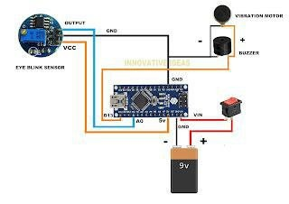


BLOCK DIAGRAM

Slide 11
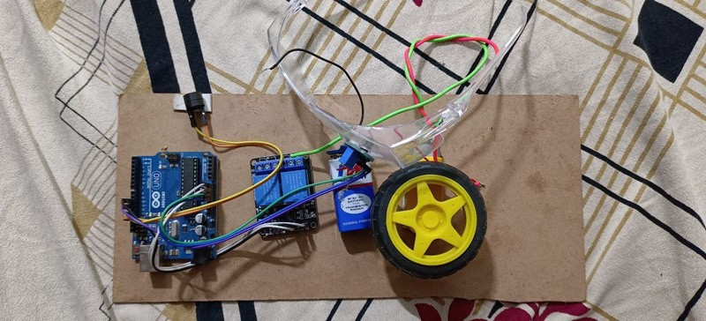
KL UNIVERSITY
Project Implementation
02

Slide 12
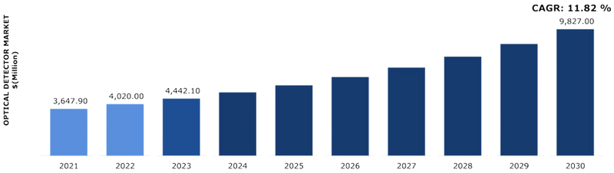
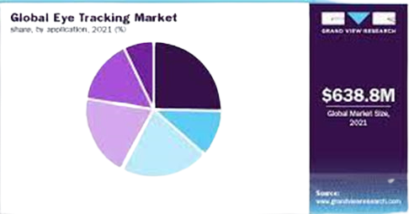

Market Overview
KL UNIVERSITY
The global eye tracking market size was valued at USD 631 million in 2021 and is expected to reach USD 8407.63 million in 2030 expanding at a compound annual growth rate (CAGR) of 33.34% from 2022 to 2030.

Slide 13


Challanges
KL UNIVERSITY
Despite its numerous benefits, the anti-accident sensor using spects eye sensor also faces some challenges. One of the main challenges is the cost of implementing this technology. The sensors and alarm system can be expensive, which may make it difficult for some industries to adopt this technology.
Another challenge is the need for proper training and education on how to use this technology. Without proper training, users may not be able to fully utilize the technology and may not receive the full benefits of this innovation.

Slide 14

Quote
KL UNIVERSITY
Always Think Safety No Matter What the Task.
Don't Be a Fool - Cause Safety is Cool - So Make that Your Rule

Slide 15


Market analysis
KL UNIVERSITY
40
30
The global market for anti-accident eye sensors is expected to grow significantly in the coming
years. According to a report by Markets and
20
Markets, the market for driver monitoring systems (which includes anti-accident eye sensors) was valued at USD 717.4 million in 2020 and is expected to reach USD 1,746.4 million by 2025, growing at a CAGR of 19.4% during the forecast period.
10
0
Element 1
Element 2
Element 3
Element 4
Element 5

Slide 16

THANK YOU

